Slide 1


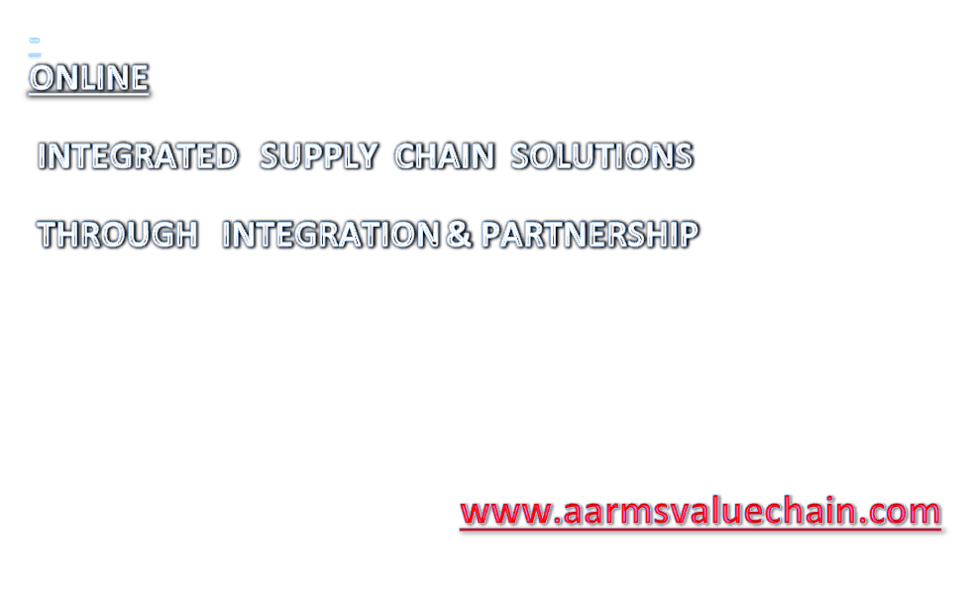

Slide 2

SUPPLY CHAIN LOGISTICS, BIDDING, REVERSE AUCTIONING, FTL MANAGEMENT-
- www.scmjunction.com, and www.scmbizconnect.com
VEHICLE TRACKING THROUGH GPS, MOBILE, GPRS. www.aaumconnect.com
AR MANAGEMENT – PAST DUES, CURRENT DUES, RECONCILIATION, CONFIRMATION OF BALANCES, www.arfocused.com
AP MANAGEMENT
CONSOLIDATED BILL PROCESSING CENTRE FOR ALL TRANSPORTATIONS (new)
C-FORM MANAGEMENT – COLLECTION OF C-FORMS, ISSUE OF C-FORMS, VAT AUDIT, BUSINESS AUDIT ETC . www.gstworkflow.com
WCT – TDS, IT TDS MANAGEMENT
DOCUMENT SCANNING – DIGITIZED, AND ONLINE SECURED SEARCH OF DOCS
www.documentsdigitized.com
CUSTOMER SUPPORT – WEB BASED ONLINE SUPPORT MANAGEMENT.
www.b2bcustomersupport.com

Slide 3

SCM SERVICES to Corporate :
E-BIDDING & REVERSE BIDDING – ONLINE
END TO END SOLUTION ON A WORKFLOW BASED SOFTWARE
Online RFQ to registered Transporters (600) .
Due diligence of all Registered Transporters.
AARMS Revenue based on Savings Model.
Bill verification, Digitized & maintain Online Audit Trail.
Can place vehicles on Spot Pan India through Registered Transporters.
AAUM Connect – Vehicle Tracking
GPS based – lowest Capex Cost.
GPS based through Mobile
GPRS loaded tracking through Mobile.
Consolidated Bill Management
Collect Bills from Transporters with supporting and complete validation and ensure Pre-verification before payment
Digitized copies for bill matching online.

Slide 4
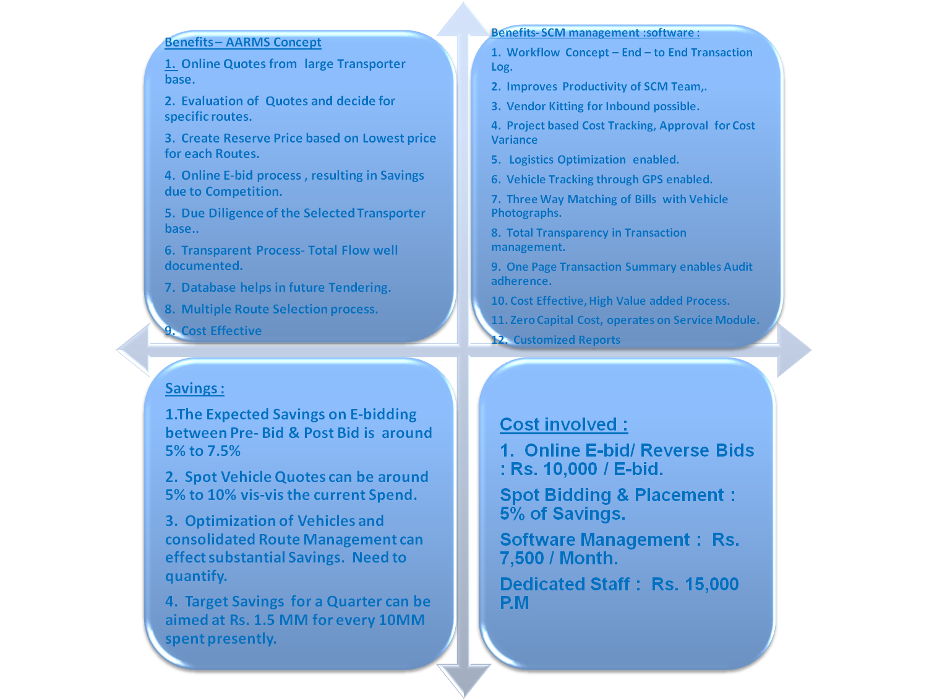

Slide 5
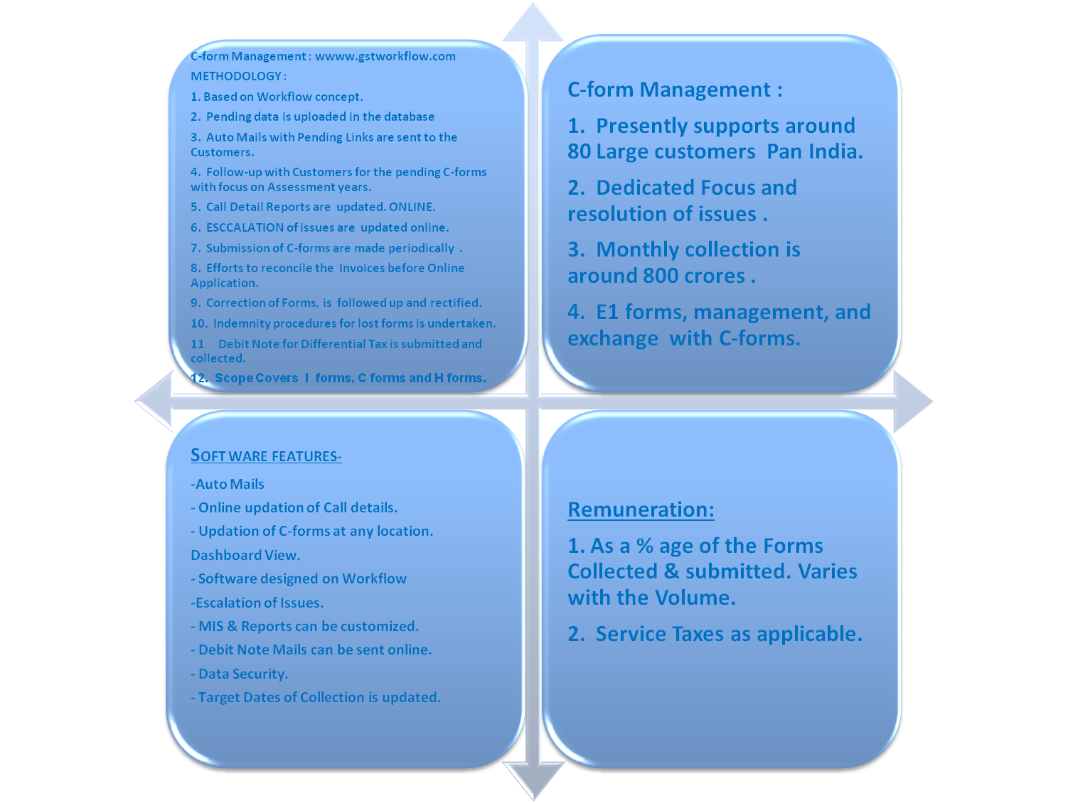

Slide 6
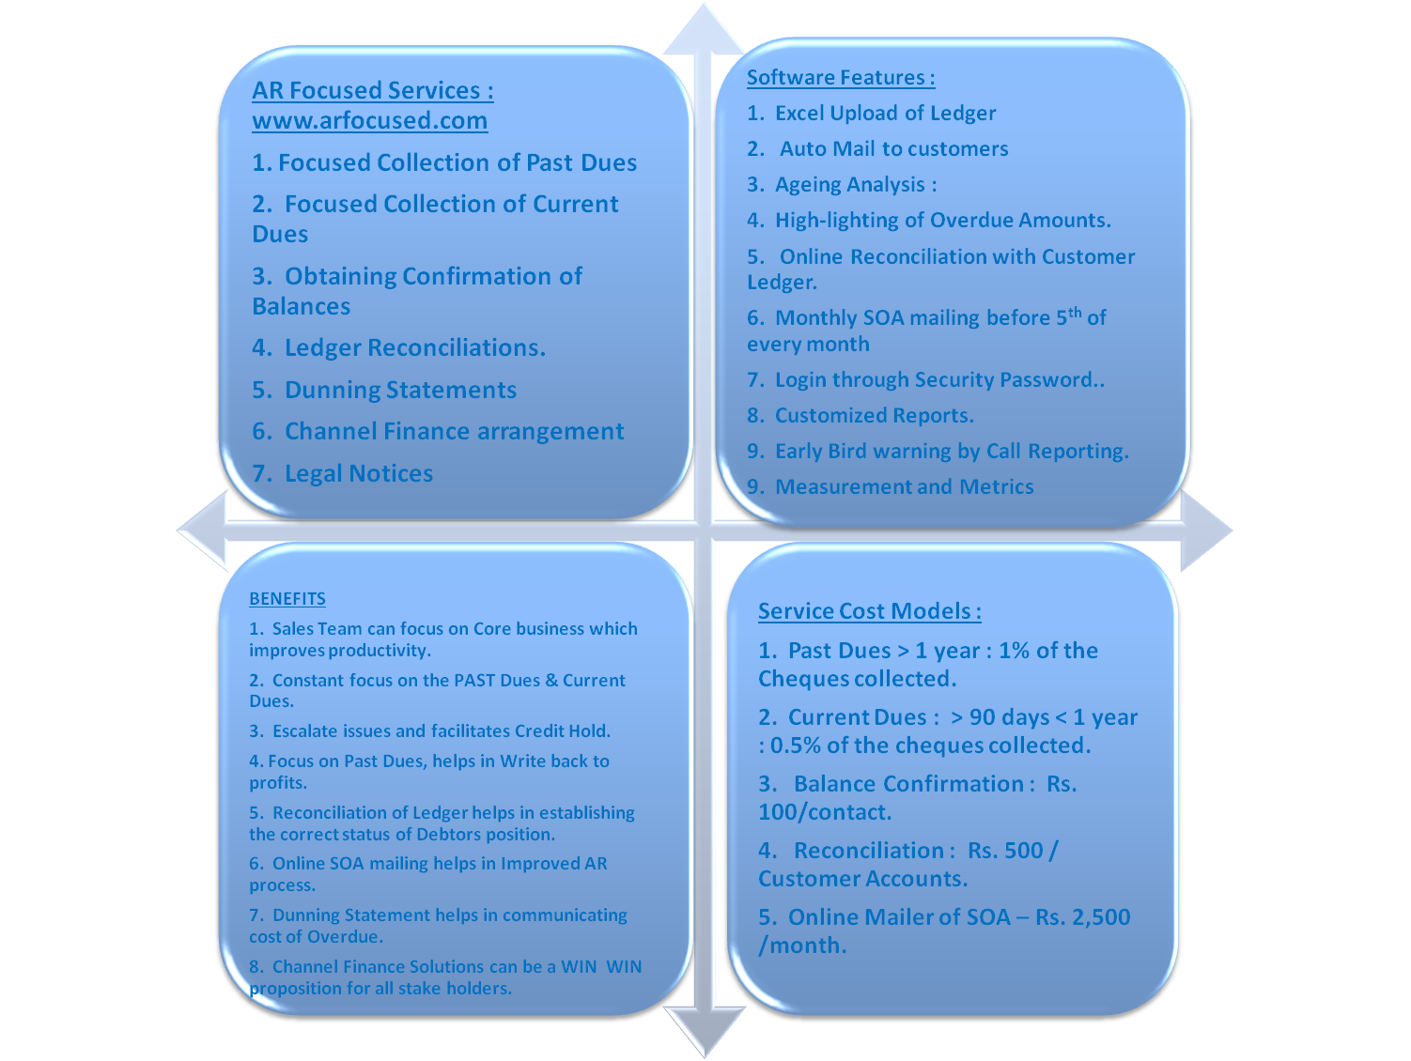

Slide 7
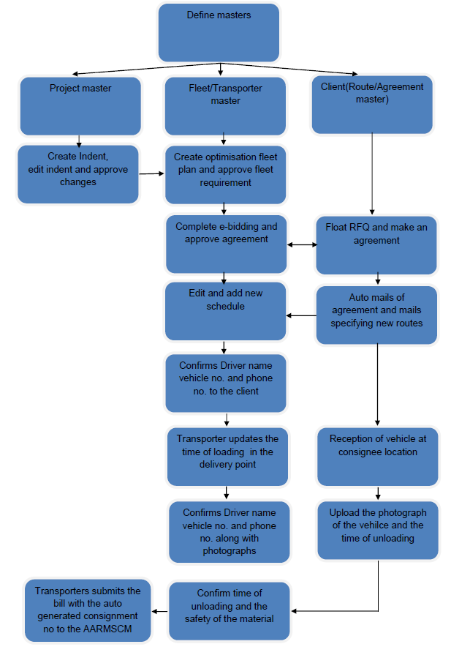

Slide 8
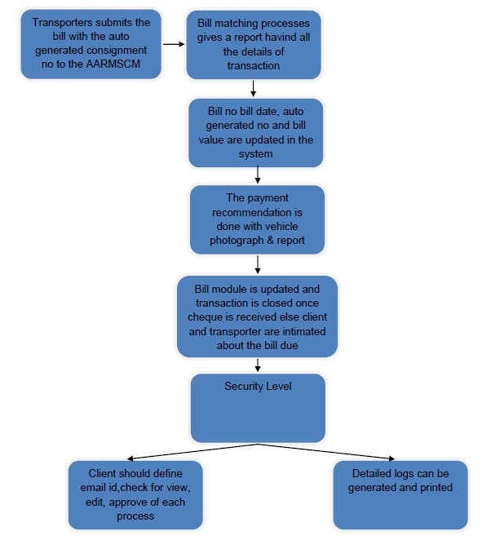

Slide 9

Freight Optimization
vehicle Planning module.
Bill Matching & Log report.
Evolve Kitting from various vendors
Linkage module to RFID integration.
Check process for ERP database.
Document Scanning for Effective Management.
Route wise Historical Cost report
Route wise Optimised Cost Report from AARMS Database for Project
Quotes.

Slide 10
ROLES & RESPONSIBILITIES
SCREEN | ACTIVITY | CLIENT ROLE | AARMS ROLE
PROJECT MASTER | PROJECT codes , Project Title, Budgeted Cost | Create for every new project
INDENT MASTER | UPLOAD INDENT FROM EXCEL | EDIT SPECIFICATION, TRACK CHANGES,
VEHICLE PLAN | UPLOAD VEHICLE PLAN FOR INDENT | SPECIFY SCHEDULE/EDIT SCH | TO MSG SCHEDULE TO FINALISED TRANSPORTERS
AGREEMENT with Transporter | LOAD AGREEMENT & SCHEDULE |  | UPDATE AGREEMENT
Vehicle Placement request | SEND MAIL FROM SCHEDULE | EDIT SCHEDULE BASED ON MATERIAL READINESS
VEHICLE CONFIRMATION | TRANSPORTER TO UPDATE VEHICLE DRIVER & MOBILE NOS | CONFIRM ONLINE .
PLACE VEHICLE | TRANSPORTER |  | RECORD CONFIRMATION NO.
TRACK LOADING | CAPTURE PHOTOS |  | UPLOAD TIME & PHOTO
TRACK VEHICLE | ONLINE VEHICLE TRACKING |  | CREATE LOGS OF VEHICLE TRACKING
TRACK RECEIPT OF GOODS | TRACK UNLOADING OF VEHICLES
BILL SUBMISSION | CAPTURE UNIQUE NO. |  | 1 PAGER WORKFLOW REPORT & CONF.
TRACK PAYMENTS | CAPTURE BILL PAYMENTS |  | CLOSE FULLY PAID.

Slide 11

TIME REQUIRED FOR IMPLEMENTATION FROM DATE OF APPOINTMENT:
PROCESS STUDY – 2 DAYS
SOFTWARE CUSTOMISATION : 5 DAYS
ACTUAL IMPLEMENTATION : 2 DAYS
NDA : AARMS Value Chain will sign a NON-DISCLOSURE AGREEMENT,
Before commencing the assignment.

